Slide 1
Output vs Outcome

Slide 2
Outputs are important products, services, profits, and revenues: the What.

Slide 3
Outcomes create meanings, relationships, and differences: the Why.

Slide 4
Outcomes are the difference made by the outputs

Slide 5
In education:
test results (outputs)
know how to apply what they've learned to the world at large (outcome),

Slide 6
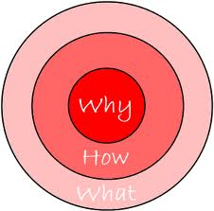
Start with Why
http://www.startwithwhy.com/
http://www.ted.com/talks/simon_sinek_how_great_leaders_inspire_action.html

Slide 7
Problem-Solution

Slide 8
5 whys

Slide 9
example
用户说：我的“需求”是：我要一匹更快的马
（用户给的往往不是“需求”，而是“方案”）更快的马是一种方案，需求可能是“更快地从A城市达到B城市”。
问Why，才能挖掘出用户的真正需求。然后可以给出更好的方案，比如说：给用户发明“汽车”。

